Slide 1
Database of an Orange Juice Manufacture
Team:
Jingnan Qi, Yan Wang, Jing Kunzler, Xiang Pan
(each task was completed collaboratively)

Slide 2
Proposal
Our company is a small orange juice manufacturer. We purchase organic oranges from different farms (suppliers) across the country once a month. The oranges are shipped from the farms to our factory by trucks of our own logistic team. Once the oranges come in, they will first be stored in oranges warehouses before making bottles of orange juice. Every ten oranges will be made into one bottle juice. After being produced, bottles of juice will be stored in juice warehouses and wait to be shipped to the wholesales.

Slide 3
Proposal (cont’d)
In order to risk control and ensure accountability of the whole process, we need to track information and status of each orange, order, delivery, orange warehouse, batch produced, and juice warehouse, as subpar scenarios arise. We also need to keep track of the real-time inventories of oranges and bottles of juice in the separate warehouses so we can adapt to market performance.

Slide 4
Assumptions
Suppliers:
We currently have 4 orange suppliers, and in the future we might increase/decrease numbers of suppliers as needed. Each supplier is uniquely and artificially identified.
We only source from US suppliers. International sourcing is not considered at current scope.
We only source from one supplier per state where oranges are most produced for ease of management.
The format of state is abbreviated only.
The format of phone numbers is no country code and no space only.
Orders:
An order is linked to the supplier it’s from. A supplier can deliver multiple orders, but an order must be fulfilled by only one supplier at a time. Each order is uniquely and artificially identified.
An order has a date (yyyy/mm/dd) when it left the supplier, and a date (yyyy/mm/dd) when it arrived our orange warehouse. If an order has been placed but has yet to arrive, its arrival date must be left blank until it has arrived.
Each order must contain a status: Placed, In-transit, or Delivered.
Upon arrival, each order must be placed into warehouses within the same day.

Slide 5
Assumptions (cont’d)
Logistic:
Our company manages logistics internally (i.e. not outsourcing).
Each truck only delivers one order at a time, but each truck can be associated with multiple orders that are cross time.
Orange Warehouse:
When orders arrive at our orange warehouse system, they can be stored in various warehouses. Each current warehouse has a max capacity of 5000 oranges, but both the number of warehouses and the max capacity can be subjected to change in the future.
Each warehouse is subjected to move oranges to the juice assembly lines within a week of arrival date (the same as order delivery date), so the max number of days oranges can stay in each warehouse is 7 days.

Slide 6
Assumption (cont’d)
Bottled Juice:
Orange juice on the assembly lines will be immediately made into bottled juice. Every ten oranges makes one bottle of juice.
As soon as a batch of bottled juice is made, it will be stored immediately to the juice warehouses.
Every batch of juice will have its batch ID, and production date (yyyy/mm/dd) printed on the bottle.
Juice Warehouse:
We have multiple juice warehouses that each has a max capacity of 5000 bottles.
The max days stocked in each warehouse is 99 days, i.e. within 100 days a bottle of juice must be sold.
This database only serves up to the juice warehouse. Sales stage would be managed by a finance database which the finance department is in charge of.

Slide 7
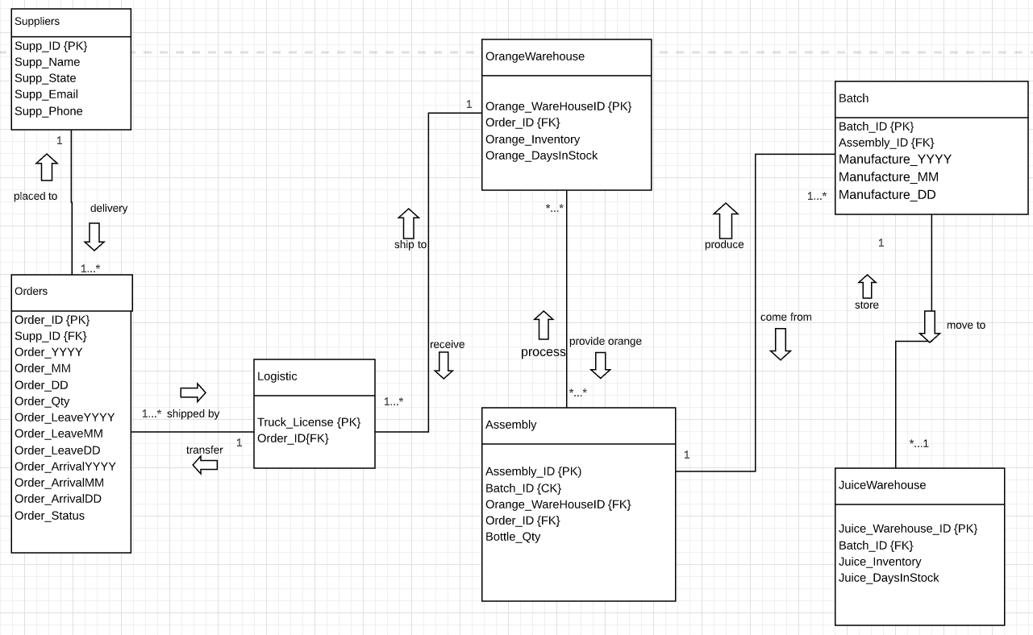
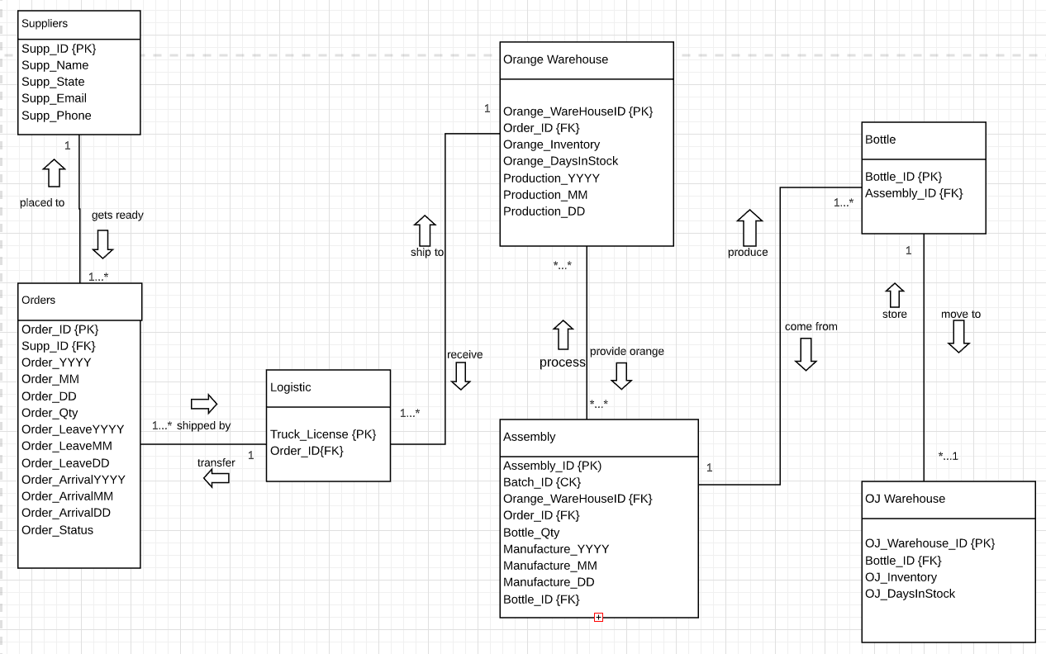
Relational Model

Slide 8
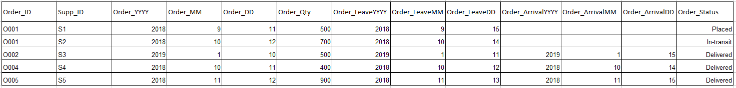
Relation Before Normalization
Order(Order_ID, Supp_ID, Order_YYYY, Order_MM, Order_DD, Order_Qty, Order_LeaveYYYY, Order_ArrivalMM, Order_ArrivalDD, Order_Status)

Slide 9
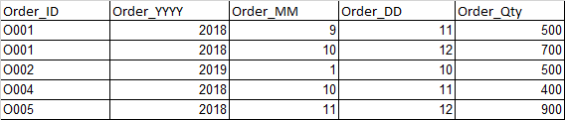
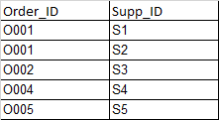
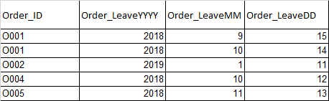
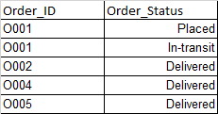
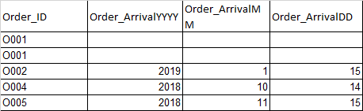
3NF

Slide 10
Other normalized to 3NF relations not shown via pictures:
Orange_Warehouse → OWarehouse_Order, Orange_Warehouse
Assembly → Merged with Batch (during 2NF)
Batch → Batch_OWarehouse, Batch
Juice_Warehouse → JWarehouse_Batch, Juice_Warehouse
Using the same normalization technique as Order, shown in the last slide.

Slide 11
Schemas & Functional Dependencies
Supplier(SupplierID, Supp_Name, Supp_State, Supp_Email, Supp_Phone) FD: SupplierID > Supp_Name, Supp_State, Supp_Email, Supp_Phone
Order_Supplier(Order_ID, Supp_ID {FK}) FD: OrderID > Supp_ID
Order_Info(Order_ID, Order_YYYY, Order_MM, Order_DD, Order_Quantity) FD: Order_ID > Order_YYYY, Order_MM, Order_DD, Order_Quantity
Order_LeaveInfo(Order_ID, Order_LeaveYYYY, Order_ArrivalMM, Order_ArrivalDD) FD: Order_ID > Order_LeaveYYYY, Order_ArrivalMM, Order_ArrivalDD
Order_ArrivalInfo(Order_ID, Order_ArrivalYYYY, Order_ArrivalMM, Order_ArrivalDD) FD: Order_ID, Order_ArrivalYYYY, Order_ArrivalMM, Order_ArrivalDD
Order_Status(Order_ID, Order_Status {FK}) FD: OrderID > Order_Status
Logistic(Truck_License, Order_ID {FK}) FD: Truck_License > OrderID
OWarehouse_Order(WarehouseO_ID, Order_ID {FK}) FD: WarehouseO_ID > OrderID
Orange Warehouse(WarehouseO_ID, Orange_Inventory, Orange_DaysinStock) FD: WarehouseO_ID > Orange_Inventory, Orange_DaysinStock
Batch_OWarehouse(Batch_ID, WarehouseO_ID {FK}) FD: Batch_ID > WarehouseO_ID
Batch(Batch_ID, Bottle_Qty, Batch_YYYY, Batch_MM, Batch_DD) FD: Batch_ID > Bottle_Qty, Batch_YYYY, Batch_MM, Batch_DD
JWarehouse_Batch(WarehouseJ_ID, Batch_ID {FK}) FD: WarehouseJ_ID > Batch_ID

Slide 12
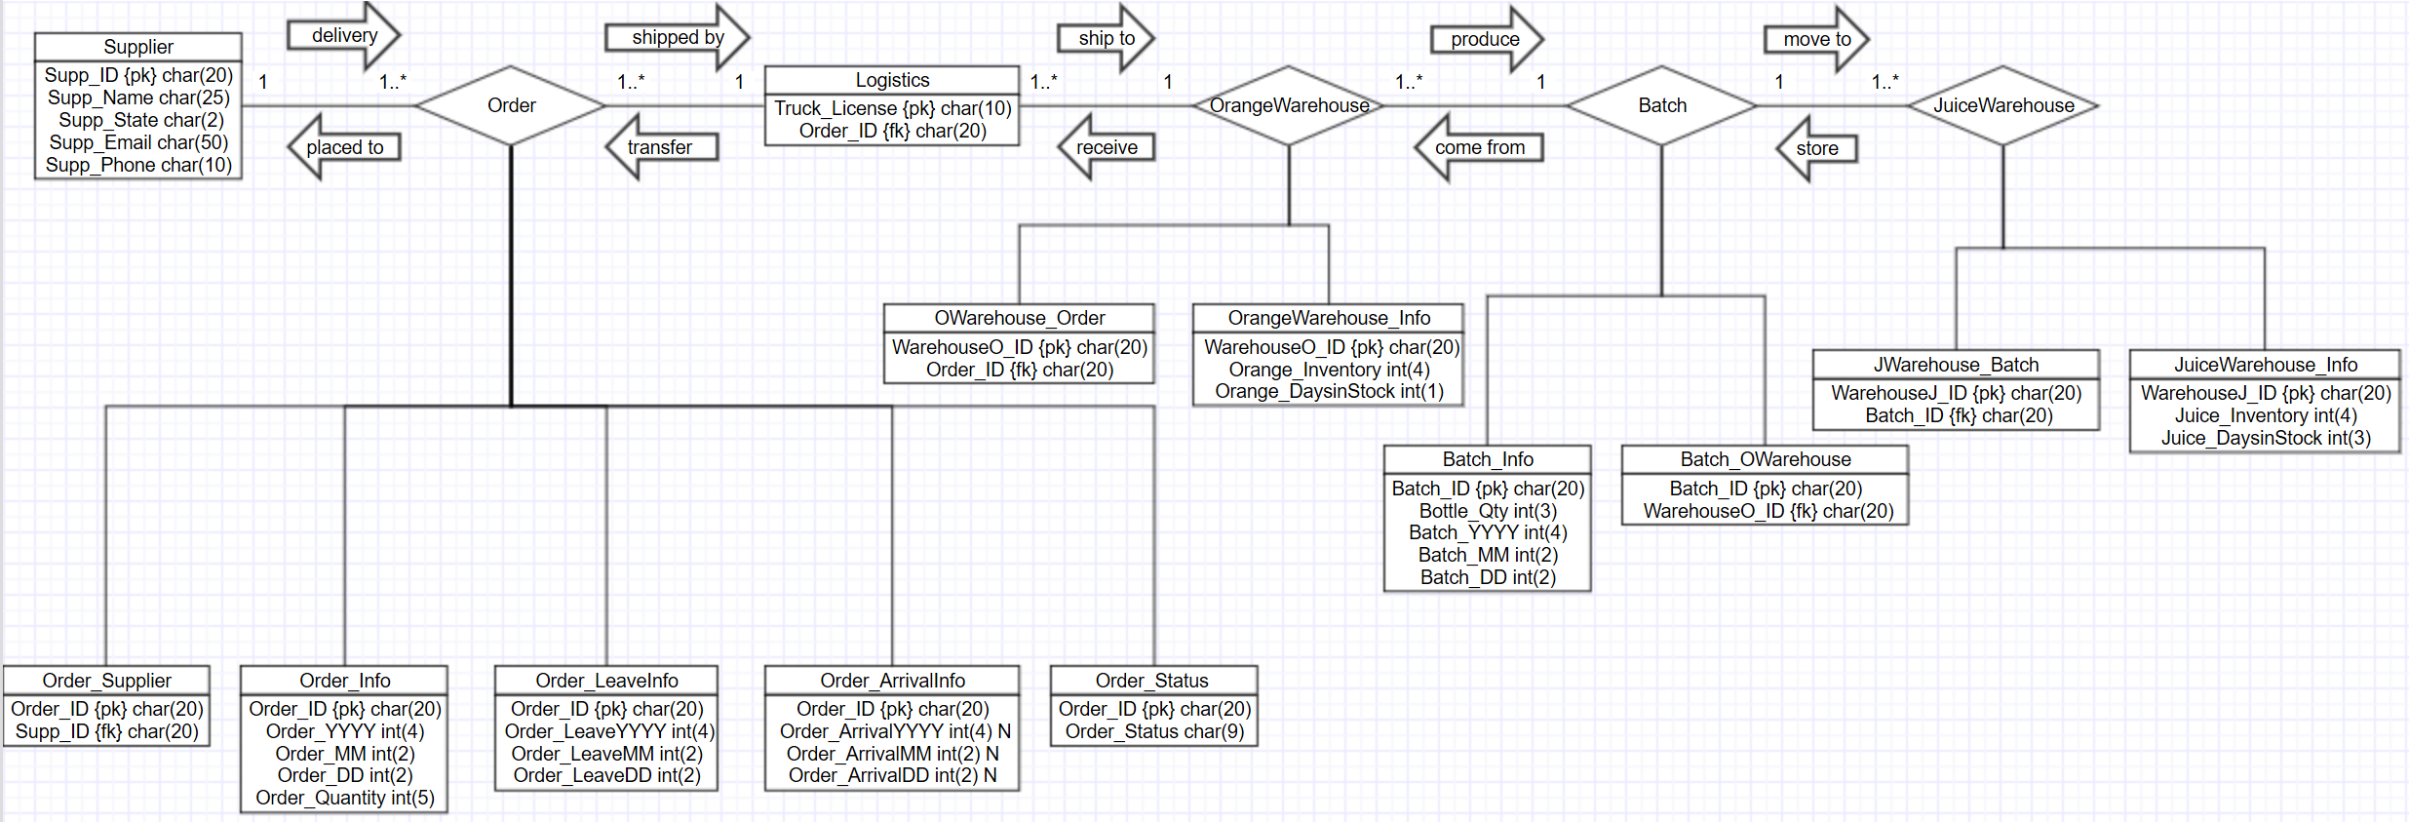
Physical Model after Normalization

